Slide 1
Mathematical Foundations for ML (10-606):
Statistics: estimation
Bryan Wilder
* Slides borrowed from prior offerings by Professors M. Gormley, P. Virtue, & G. Gordon, & H. Heidari.

Slide 2
Announcements
Final quiz Friday, during recitation slot (2-3pm)
Scope: all of probability and statistics + optimization (i.e., first/second order conditions, convexity, etc)

Slide 3
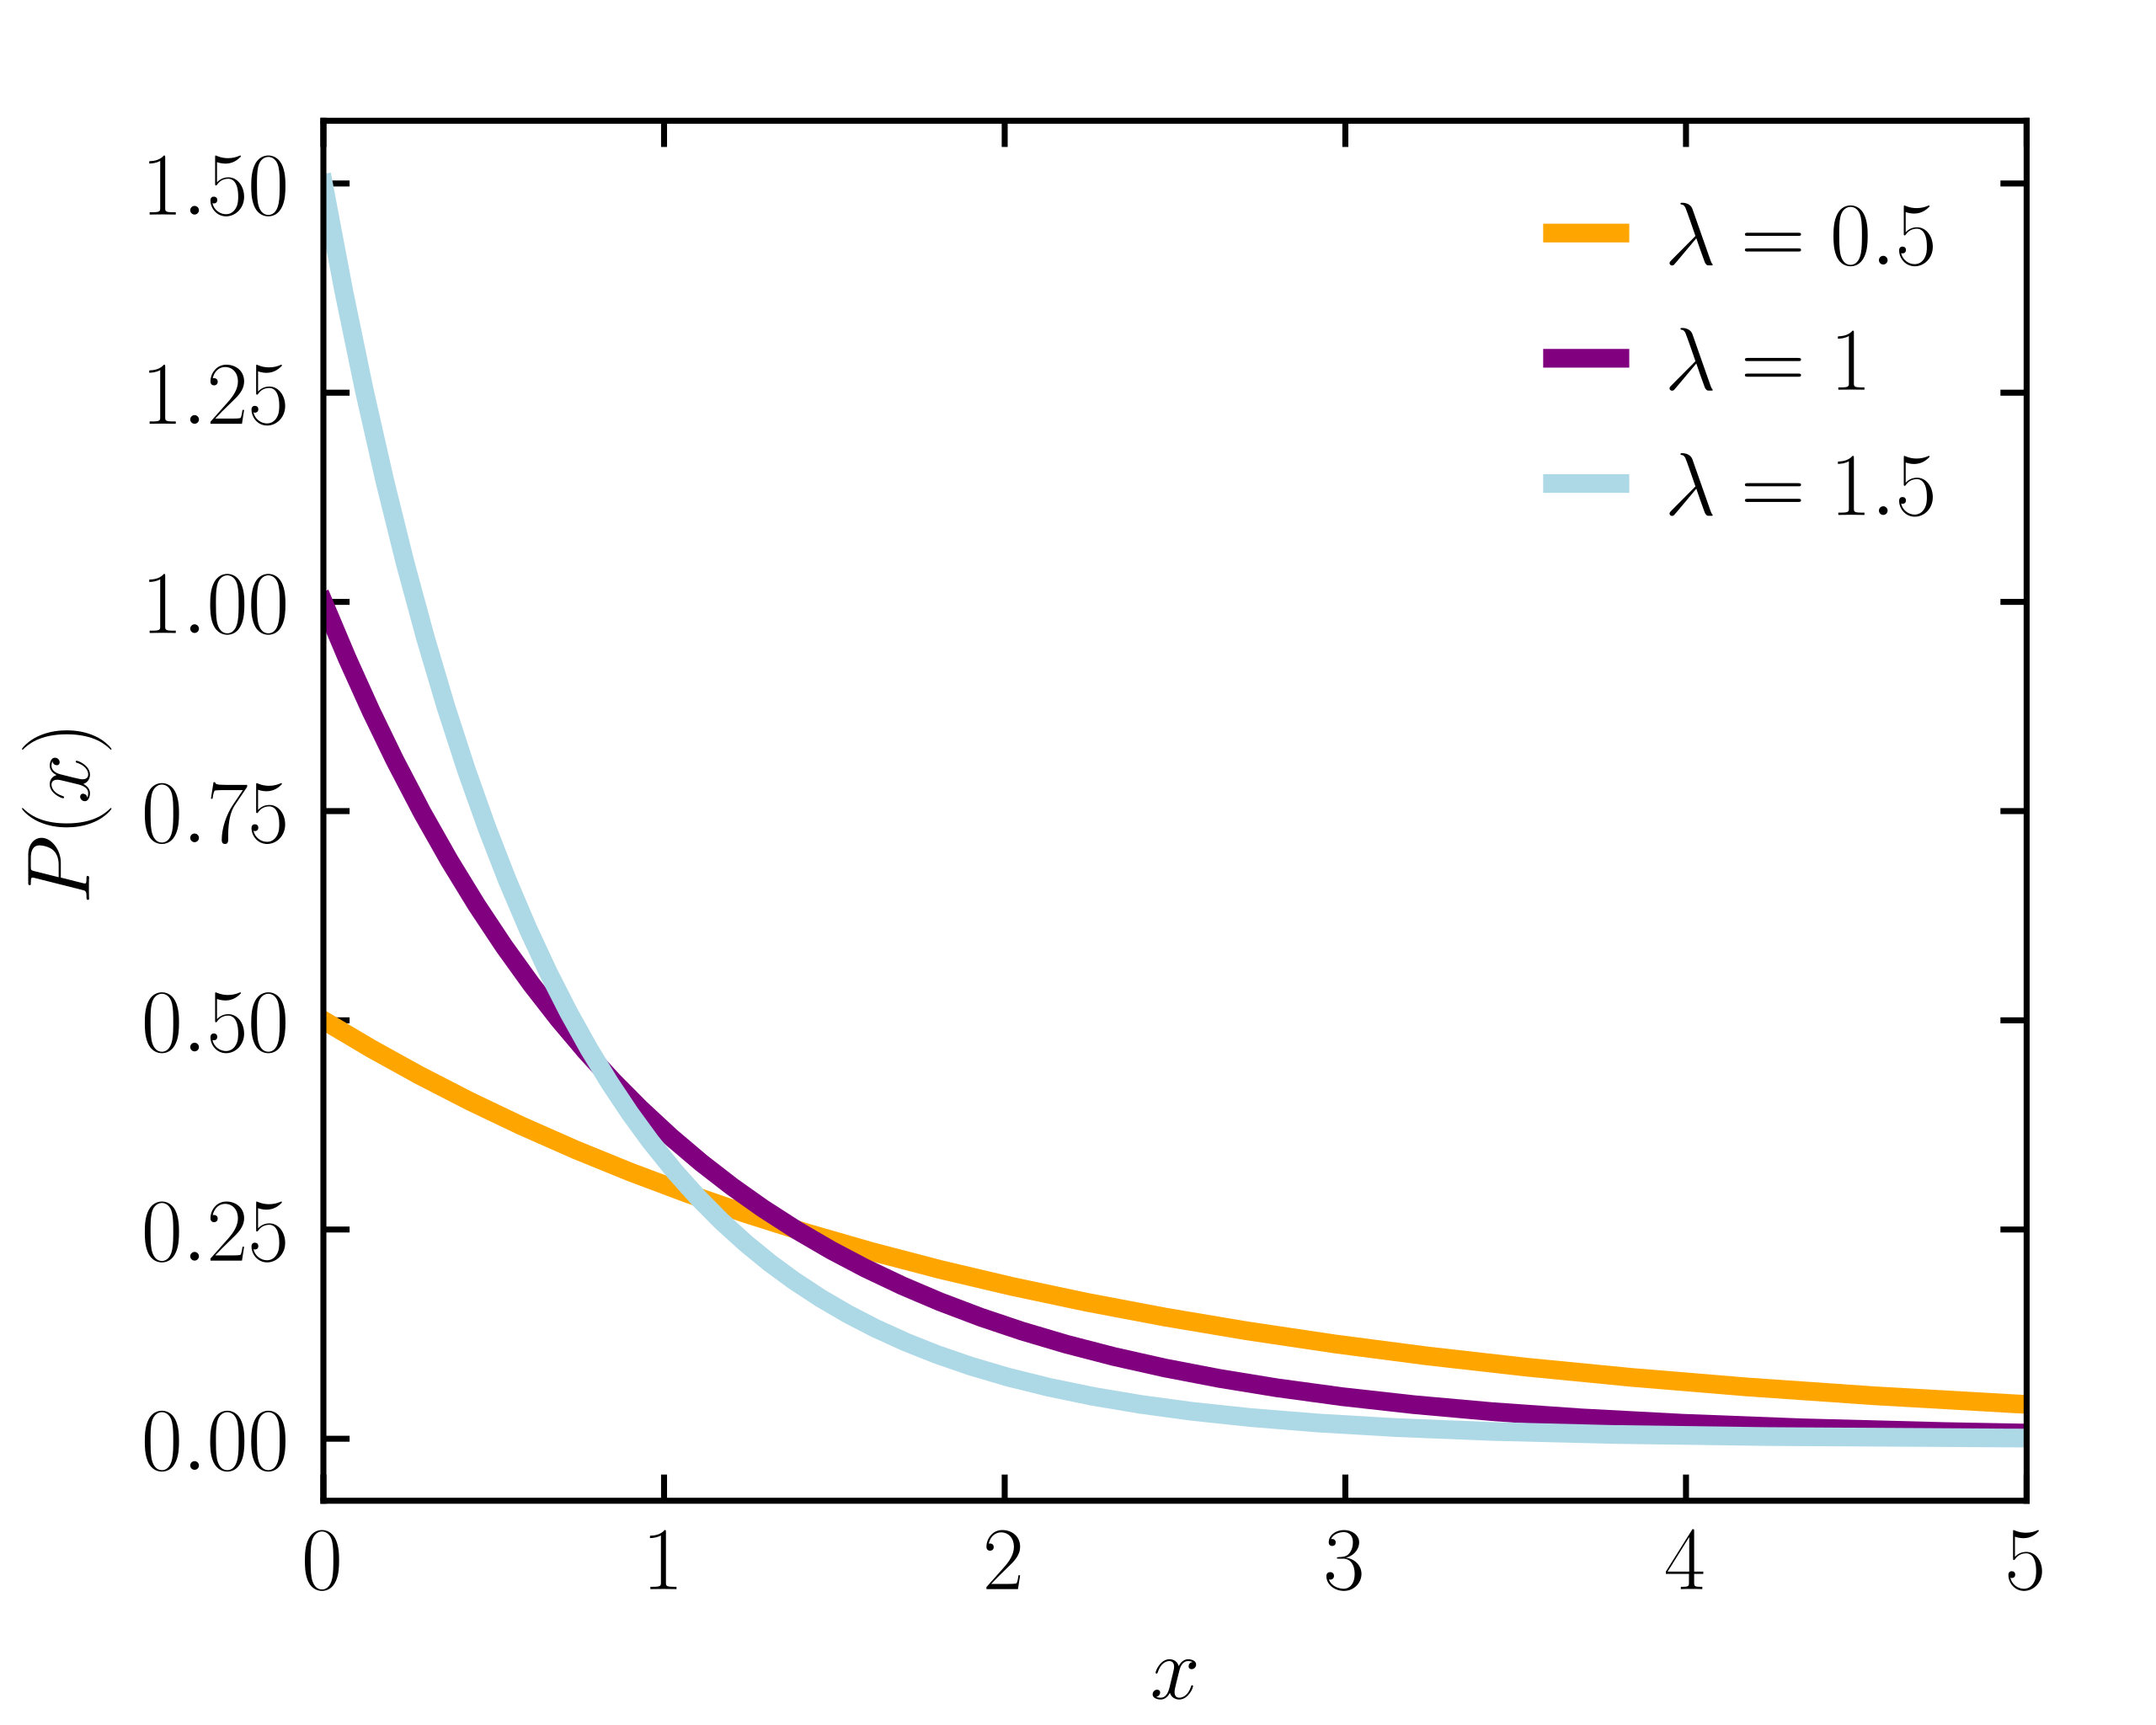
Maximum Likelihood Estimation (MLE)
Issue: many common probability distributions have parameters that we need to specify in order to use them
Idea: set the parameter(s) so that the likelihood of the samples is maximized
Intuition: assign as much of the (finite) probability mass to the observed data at the expense of unobserved data
Example: the exponential distribution

Slide 4
Maximum Likelihood Estimation (MLE)
Issue: many common probability distributions have parameters that we need to specify in order to use them
Idea: set the parameter(s) so that the likelihood of the samples is maximized
Intuition: assign as much of the (finite) probability mass to the observed data at the expense of unobserved data
Example: the exponential distribution
$$\left\{x^{\left(1\right)}=0.5, x^{\left(2\right)}=1\right\}$$

Slide 5
Maximum Likelihood Estimation (MLE)
Issue: many common probability distributions have parameters that we need to specify in order to use them
Idea: set the parameter(s) so that the likelihood of the samples is maximized
Intuition: assign as much of the (finite) probability mass to the observed data at the expense of unobserved data
Example: the exponential distribution
$$\left\{x^{\left(1\right)}=2, x^{\left(2\right)}=3\right\}$$

Slide 6
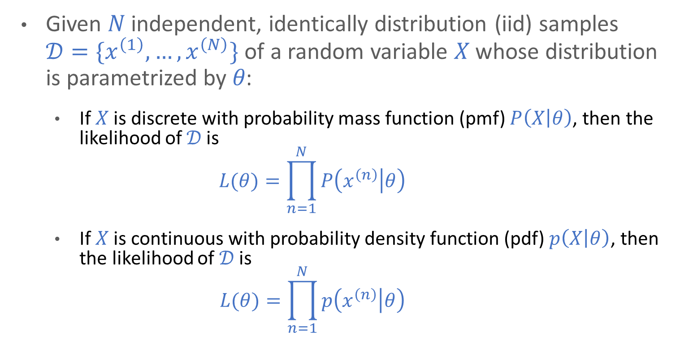
Likelihood
Given 𝑁 independent, identically distribution (iid) samples $𝒟=\{x^{\left(1\right)}, …, x^{\left(N\right)}\}$ of a random variable 𝑋 whose distribution is parametrized by 𝜃:
If 𝑋 is discrete with probability mass function (pmf) $P\left(X | θ\right)$, then the likelihood of 𝒟 is
$$L(θ)=\prod_{n=1}^{N}{P\left(x^{\left(n\right)} | θ\right)}$$
If 𝑋 is continuous with probability density function (pdf) $p\left(X | θ\right)$, then the likelihood of 𝒟 is
$$L(θ)=\prod_{n=1}^{N}{p\left(x^{\left(n\right)} | θ\right)}$$

Slide 7
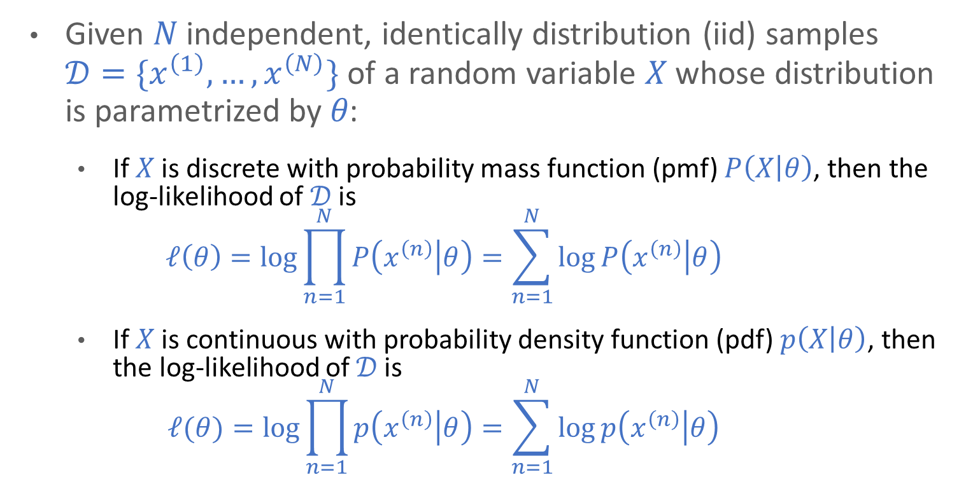
Log-Likelihood
Given 𝑁 independent, identically distribution (iid) samples $𝒟=\{x^{\left(1\right)}, …, x^{\left(N\right)}\}$ of a random variable 𝑋 whose distribution is parametrized by 𝜃:
If 𝑋 is discrete with probability mass function (pmf) $P\left(X | θ\right)$, then the log-likelihood of 𝒟 is
$$ℓ\left(θ\right)=\log{\prod_{n=1}^{N}{P\left(x^{\left(n\right)} | θ\right)}}=\sum_{n=1}^{N}{\log{P\left(x^{\left(n\right)} | θ\right)}}$$
If 𝑋 is continuous with probability density function (pdf) $p\left(X | θ\right)$, then the log-likelihood of 𝒟 is
$$ℓ(θ)=\log{\prod_{n=1}^{N}{p\left(x^{\left(n\right)} | θ\right)}}=\sum_{n=1}^{N}{\log{p\left(x^{\left(n\right)} | θ\right)}}$$

Slide 8
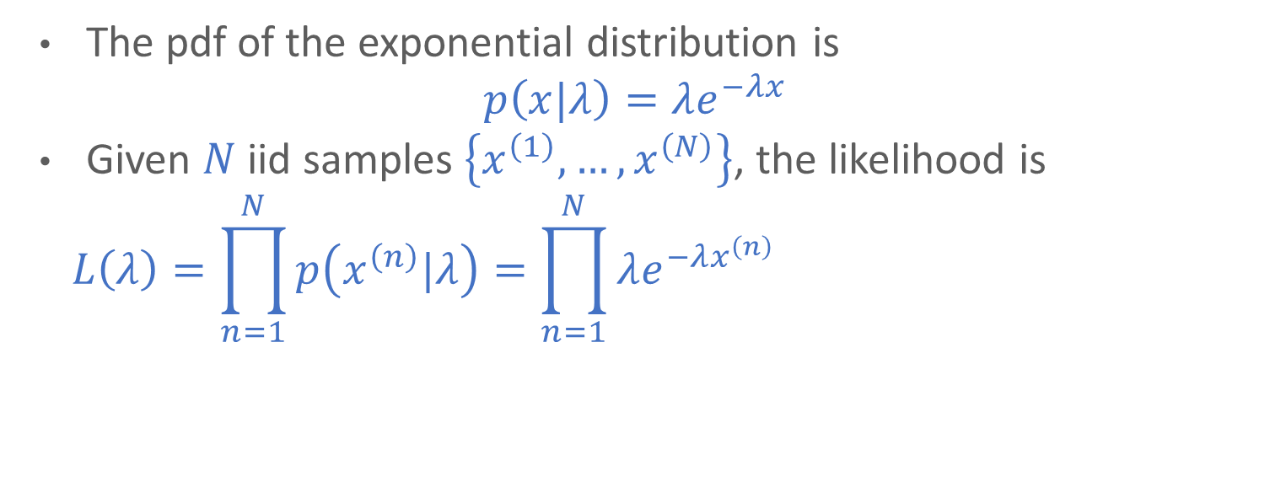
Exponential Distribution MLE
The pdf of the exponential distribution is
$$p\left(x|λ\right)=λe^{−λx}$$
Given $N$ iid samples $\left\{x^{\left(1\right)}, …, x^{\left(N\right)}\right\}$, the likelihood is
$$L\left(λ\right)=\prod_{n=1}^{N}{p\left(x^{\left(n\right)}|λ\right)}=\prod_{n=1}^{N}{λe^{−λx^{\left(n\right)}}} =\sum_{n=1}^{N}{\log{λ}+}\log{e^{−λx^{\left(n\right)}}}$$

Slide 9
Whiteboard
Converting to log-likelihood and finding the MLE

Slide 10
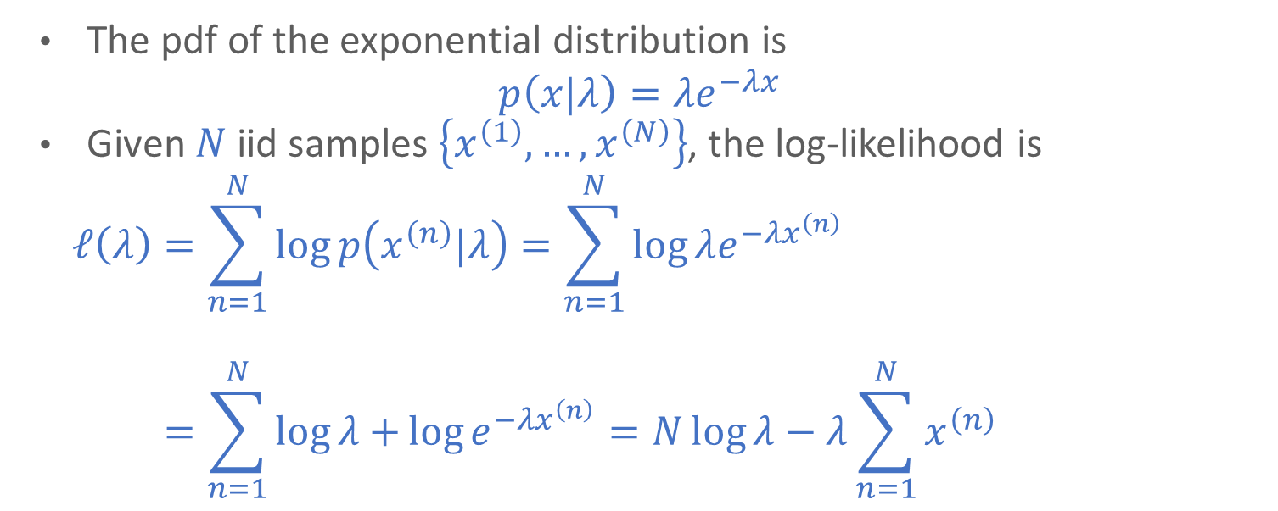
Exponential Distribution MLE
The pdf of the exponential distribution is
$$p\left(x|λ\right)=λe^{−λx}$$
Given $N$ iid samples $\left\{x^{\left(1\right)}, …, x^{\left(N\right)}\right\}$, the log-likelihood is
$$ℓ\left(λ\right)=\sum_{n=1}^{N}{\log{p\left(x^{\left(n\right)}|λ\right)}}=\sum_{n=1}^{N}{\log{λe^{−λx^{\left(n\right)}}}}$$
$$ℓ\left(λ\right)=\sum_{n=1}^{N}{\log{λ}+}\log{e^{−λx^{\left(n\right)}}}=N\log{λ}−λ\sum_{n=1}^{N}{x^{\left(n\right)}}$$

Slide 11
Exponential Distribution MLE
The pdf of the exponential distribution is
$$p\left(x|λ\right)=λe^{−λx}$$
We can solve for the optimal value of $λ$ by taking the partial derivative of the log-likelihood and setting it equal to $0$:
$$ℓ\left(λ\right)=N\log{λ}−λ\sum_{n=1}^{N}{x^{\left(n\right)}}$$
$$\frac{∂ℓ}{∂λ}=\frac{N}{λ}−\sum_{n=1}^{N}{x^{\left(n\right)}} \\ →\frac{N}{\hat{λ}}−\sum_{n=1}^{N}{x^{\left(n\right)}}=0→\frac{N}{\hat{λ}}=\sum_{n=1}^{N}{x^{\left(n\right)}}→\hat{λ}=\frac{N}{\sum_{n=1}^{N}{x^{\left(n\right)}}}$$

Slide 12
Exponential Distribution MLE
The pdf of the exponential distribution is
$$p\left(x|λ\right)=λe^{−λx}$$
We can solve for the optimal value of $λ$ by taking the partial derivative of the log-likelihood and setting it equal to $0$:
$$ℓ\left(λ\right)=N\log{λ}−λ\sum_{n=1}^{N}{x^{\left(n\right)}}$$
$$\frac{∂ℓ}{∂λ}=\frac{N}{λ}−\sum_{n=1}^{N}{x^{\left(n\right)}} \\ →\frac{N}{\hat{λ}}−\sum_{n=1}^{N}{x^{\left(n\right)}}=0→\frac{N}{\hat{λ}}=\sum_{n=1}^{N}{x^{\left(n\right)}}→\hat{λ}=\frac{N}{\sum_{n=1}^{N}{x^{\left(n\right)}}}$$

Slide 13
Another example
MLE of the univariate Gaussian distribution

Slide 14
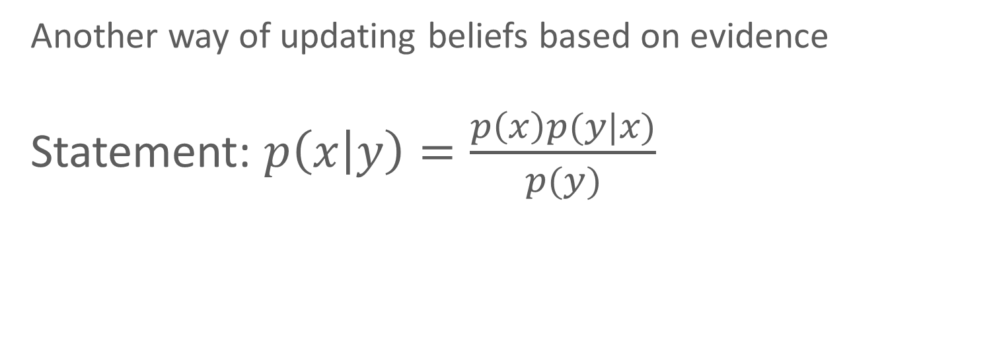
Bayes theorem
Another way of updating beliefs based on evidence
Statement: $p\left(x | y\right)=\frac{p\left(x\right)p(y|x)}{p(y)}$

Slide 15
Bayes theorem
Suppose that a bag has two coins: one fair and one unfair. For the unfair coin, p(heads) = 0.7
I take a coin out of the bag and start flipping it. Based on the results, I want to determine whether it is fair or unfair

Slide 16
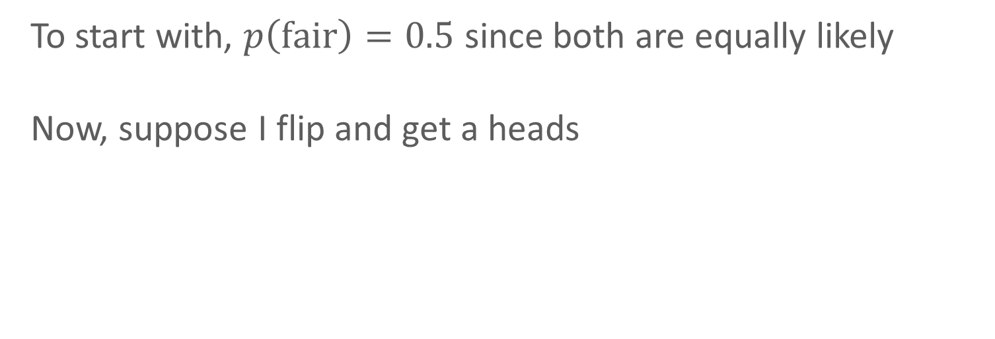
Bayes theorem
To start with, $p\left(fair\right)=0.5$ since both are equally likely
Now, suppose I flip and get a heads

Slide 17
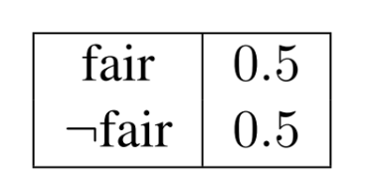
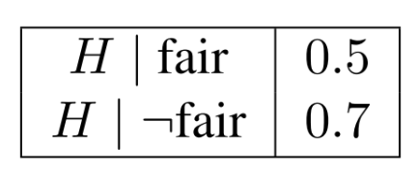
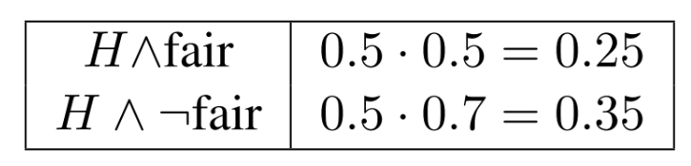

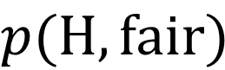
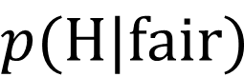
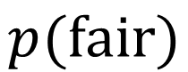

Bayes theorem
$$p(fair)$$
$$p(H|fair)$$
$$p(H,fair)$$
$$×$$
$$=$$

Slide 18
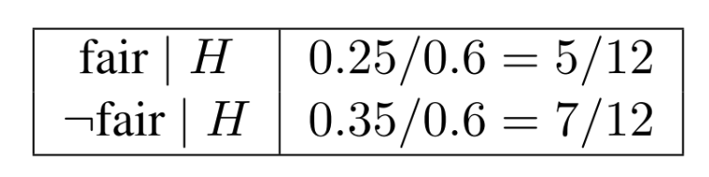

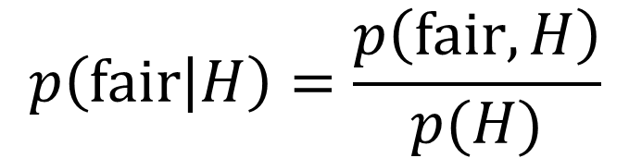
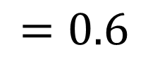
Bayes theorem
$$p(fair)$$
$$p(H|fair)$$
$$p(H,fair)$$
$$×$$
$$=$$
$$=0.6$$
$$p\left(fair | H\right)=\frac{p\left(fair, H\right)}{p(H)}$$
$$=$$

Slide 19
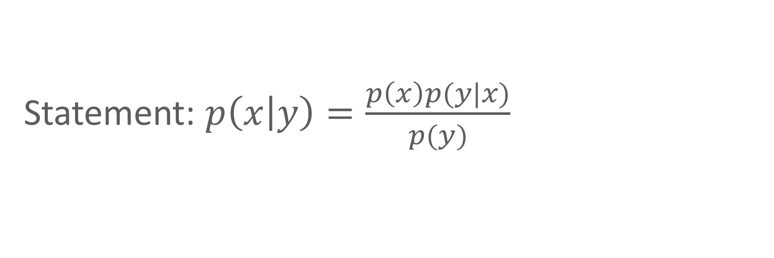
Bayes theorem
Prior
Likelihood
Statement: $p\left(x | y\right)=\frac{p\left(x\right)p(y|x)}{p(y)}$
Posterior
Evidence

Slide 20
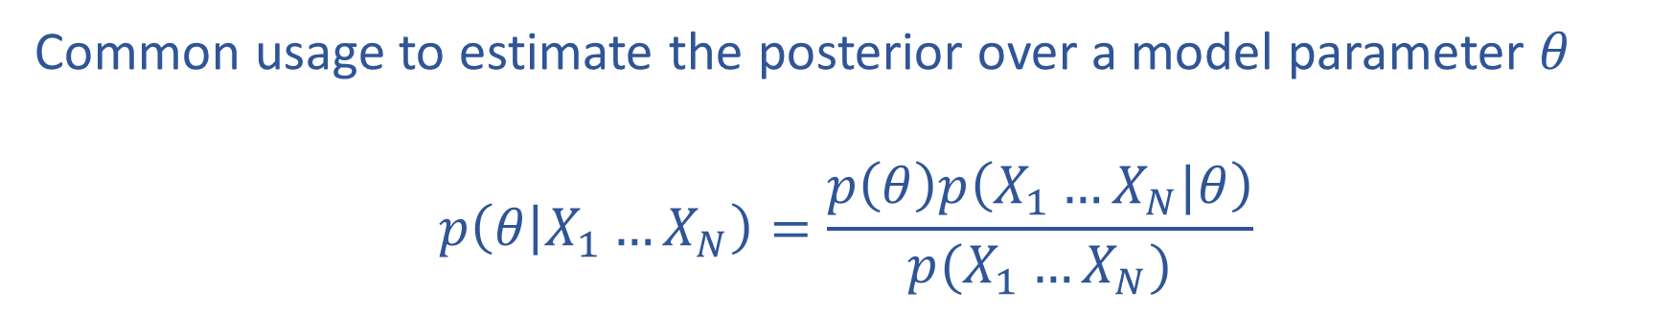
Bayes rule
Common usage to estimate the posterior over a model parameter $θ$
$$p\left(θ | X_{1}…X_{N}\right)=\frac{p\left(θ\right)p\left(X_{1}…X_{N}|θ\right)}{p(X_{1}…X_{N})}$$

Slide 21
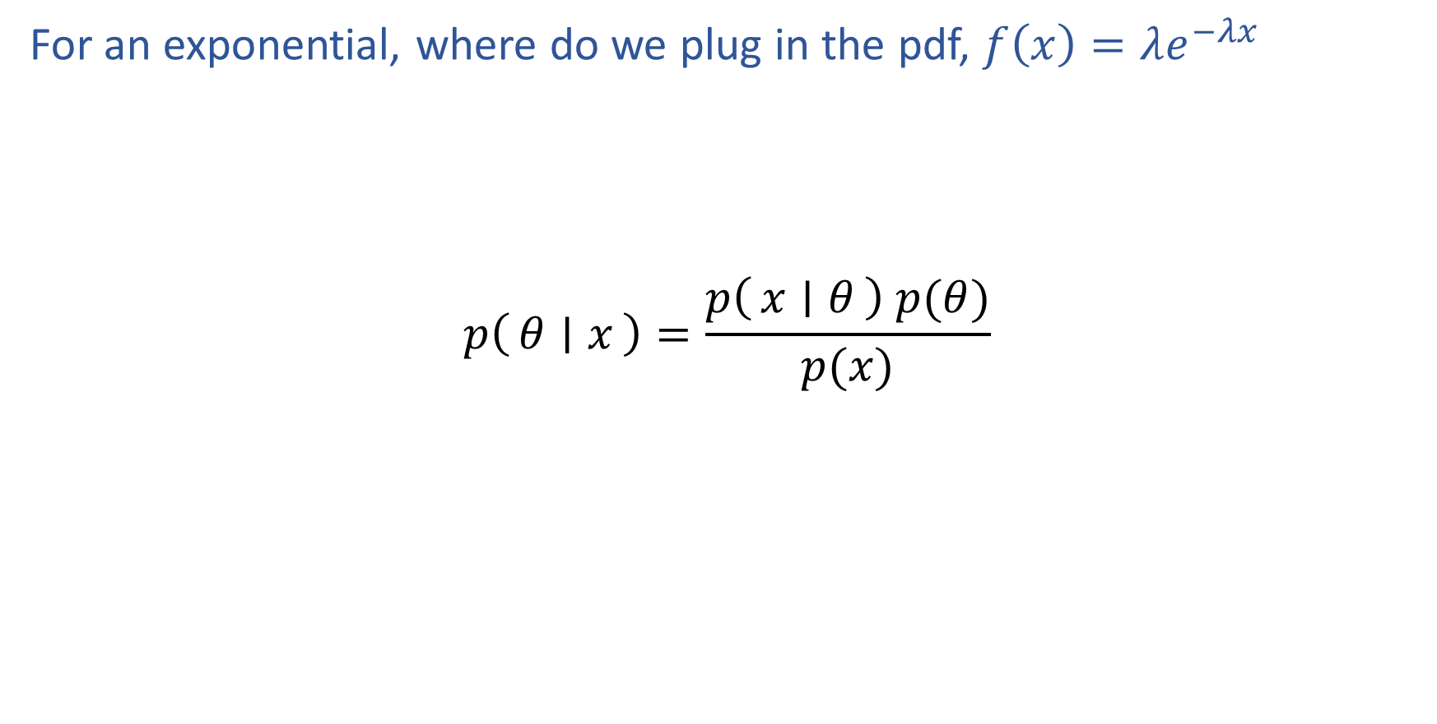
Poll 3
For an exponential, where do we plug in the pdf, $f\left(x\right)=λe^{−λx}$
$$p\left(θ ∣ x\right)=\frac{p\left(x ∣ θ\right) p(θ)}{p(x)}$$
B
C
A
D

Slide 22
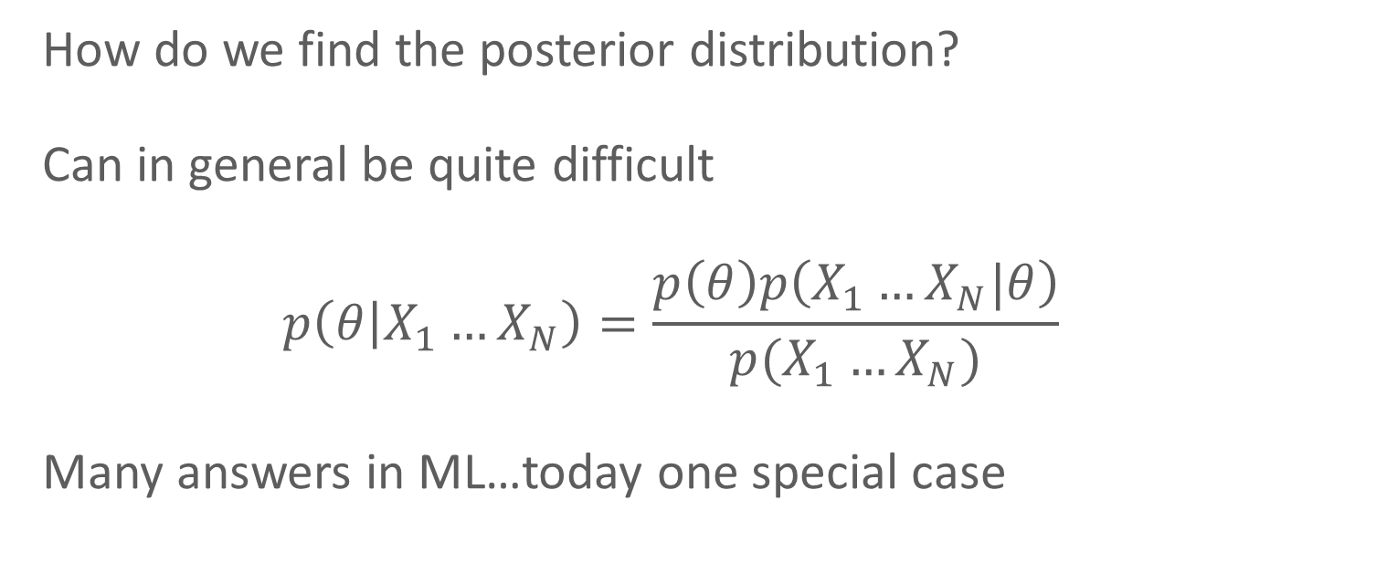
Bayesian inference
How do we find the posterior distribution?
Can in general be quite difficult
$$p\left(θ | X_{1}…X_{N}\right)=\frac{p\left(θ\right)p\left(X_{1}…X_{N}|θ\right)}{p(X_{1}…X_{N})}$$
Many answers in ML…today one special case

Slide 23
Conjugate priors
Key question: form of the prior and likelihood
For some (prior, likelihood) pairs, the posterior is in the same family as the prior (“conjugate prior”)

Slide 24
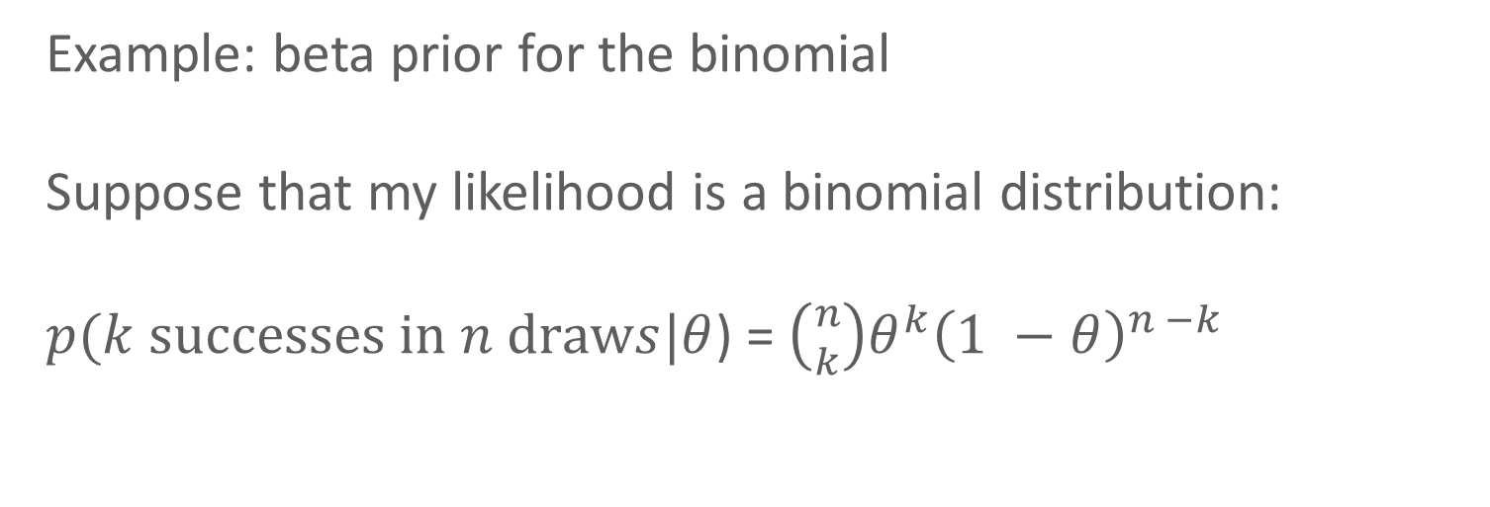
Conjugate priors
Example: beta prior for the binomial
Suppose that my likelihood is a binomial distribution:
$p(k successes in n draws|θ$) = $\left({n \atop k}\right)θ^{k}{\left(1 −θ\right)}^{n −k}$

Slide 25
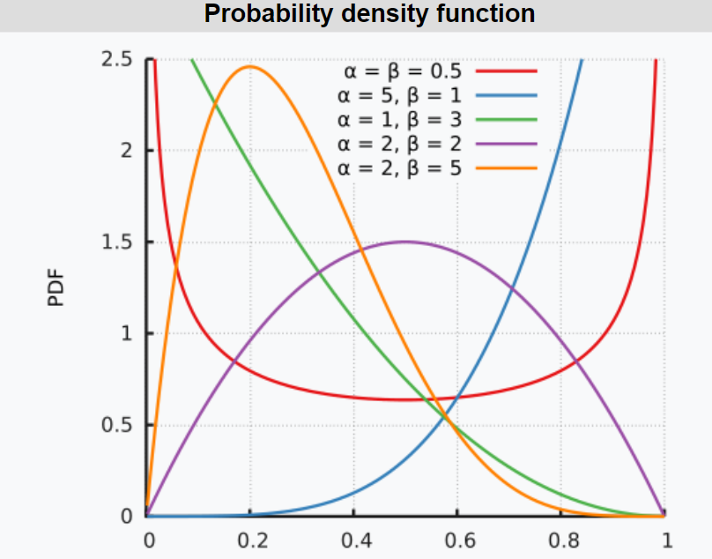
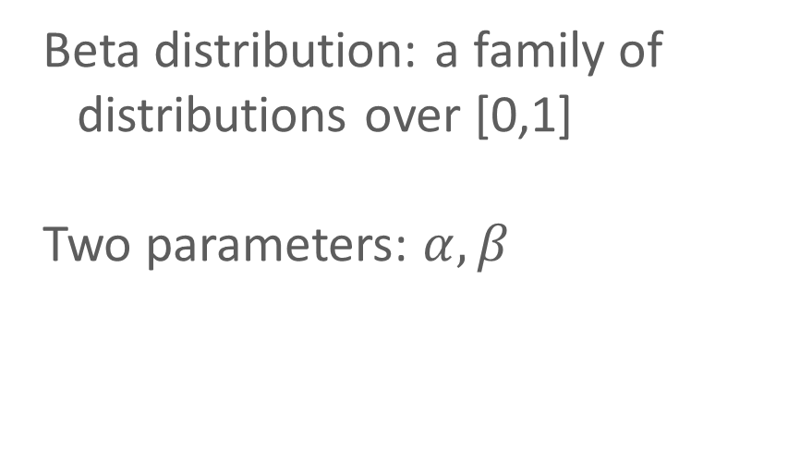
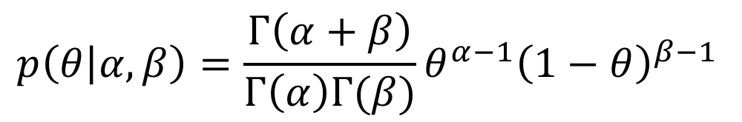
Conjugate priors
Beta distribution: a family of distributions over [0,1]
Two parameters: $α, β$
$$p\left(θ | α, β\right)=\frac{Γ\left(α+β\right)}{Γ\left(α\right)Γ(β)}θ^{α−1}{\left(1−θ\right)}^{β−1 }$$

Slide 26
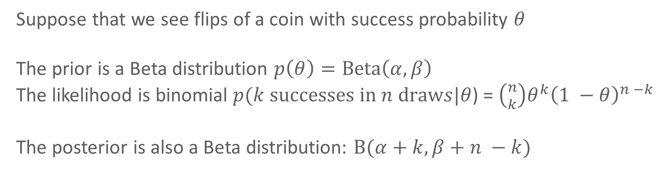
Conjugate priors
Suppose that we see flips of a coin with success probability $θ$
The prior is a Beta distribution $p\left(θ\right)=Beta\left(α, β\right)$
The likelihood is binomial $p(k successes in n draws|θ$) = $\left({n \atop k}\right)θ^{k}{\left(1 −θ\right)}^{n −k}$
The posterior is also a Beta distribution: $Β(α+k, β+n −k)$

Slide 27
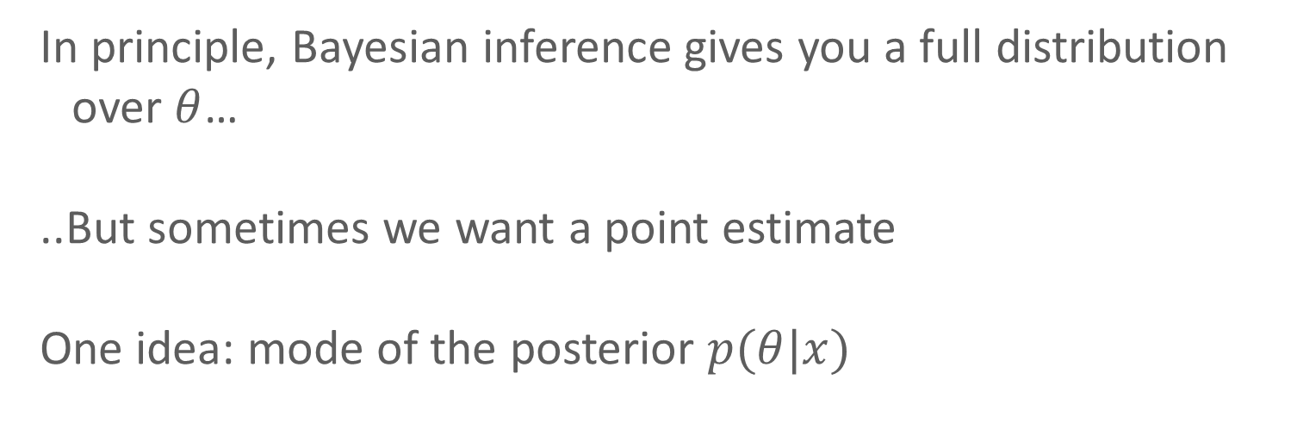
Maximum a posteriori (MAP) inference
In principle, Bayesian inference gives you a full distribution over $θ$…
..But sometimes we want a point estimate
One idea: mode of the posterior $p(θ|x)$

Slide 28
MLE vs. MAP
Maximum Likelihood Estimate (MLE)
Maximum a posteriori (MAP) estimate
Prior
Slide credit: CMU MLD Matt Gormley

Slide 29
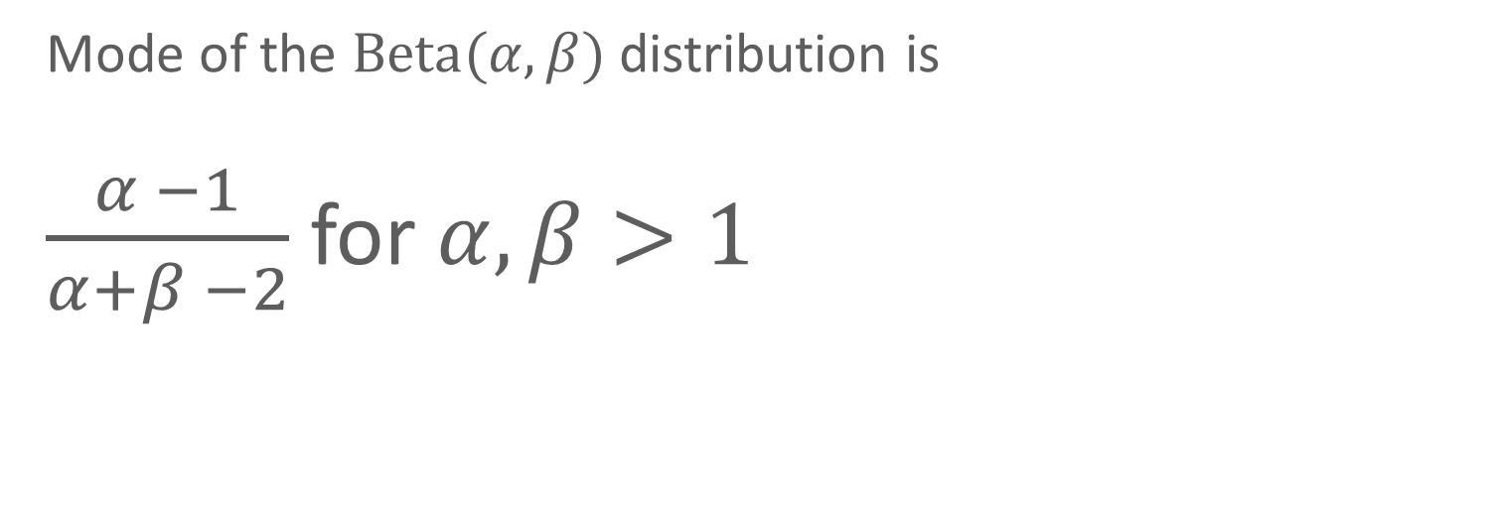
MAP for the Beta-binomial model
Mode of the $Beta(α, β)$ distribution is
$\frac{α −1}{α+β −2}$ for $α, β>1$

Slide 30
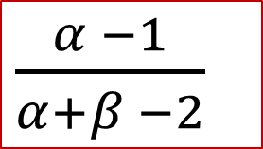
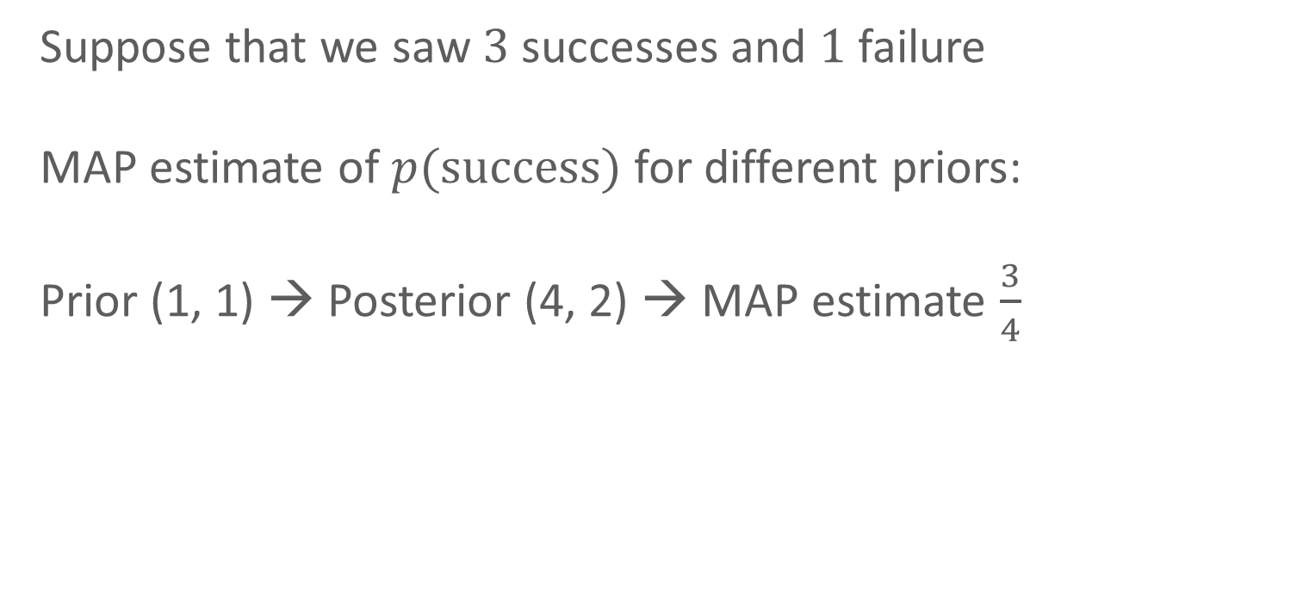
MAP for the Beta-binomial model
Suppose that we saw $3$ successes and $1$ failure
MAP estimate of $p(success)$ for different priors:
Prior (1, 1) → Posterior (4, 2) → MAP estimate $\frac{3}{4}$
$\frac{α −1}{α+β −2}$

Slide 31
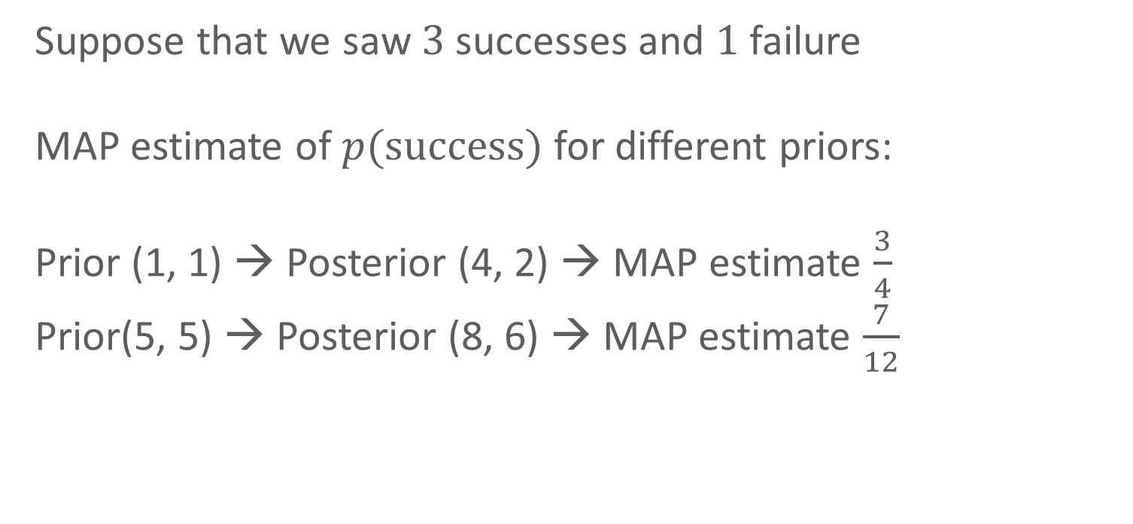
MAP for the Beta-binomial model
Suppose that we saw $3$ successes and $1$ failure
MAP estimate of $p(success)$ for different priors:
Prior (1, 1) → Posterior (4, 2) → MAP estimate $\frac{3}{4}$
Prior(5, 5) → Posterior (8, 6) → MAP estimate $\frac{7}{12}$
$\frac{α −1}{α+β −2}$

Slide 32
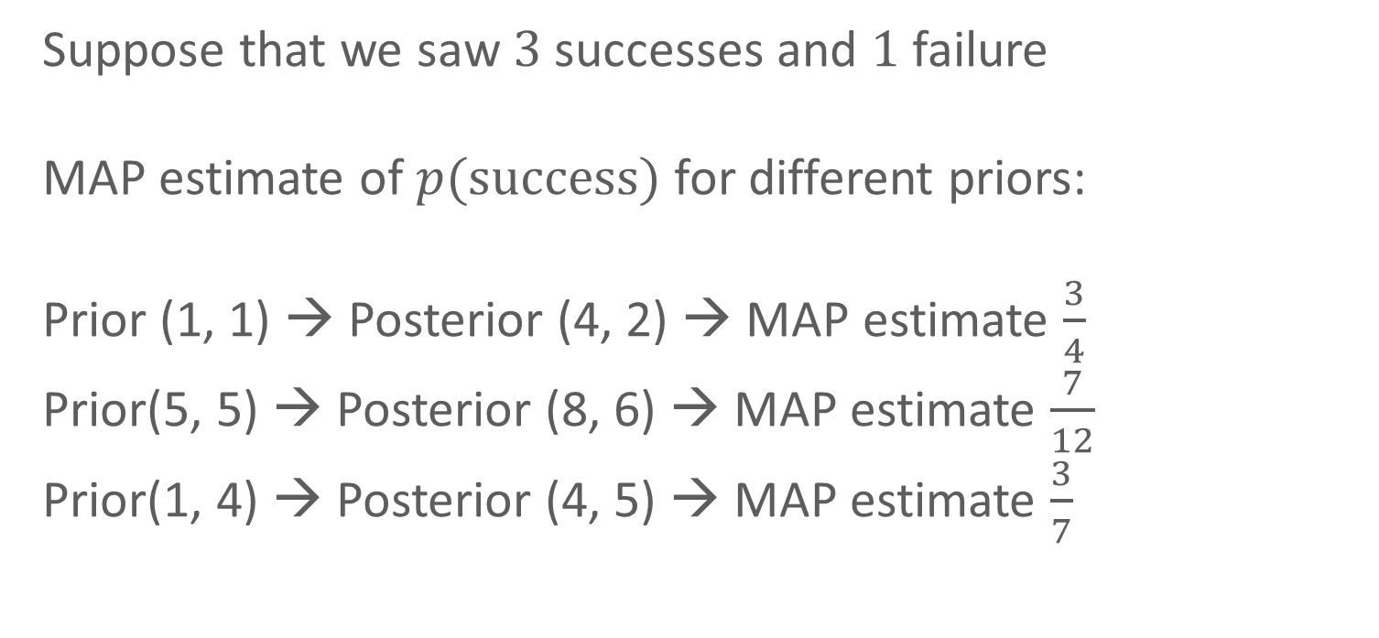
MAP for the Beta-binomial model
Suppose that we saw $3$ successes and $1$ failure
MAP estimate of $p(success)$ for different priors:
Prior (1, 1) → Posterior (4, 2) → MAP estimate $\frac{3}{4}$
Prior(5, 5) → Posterior (8, 6) → MAP estimate $\frac{7}{12}$
Prior(1, 4) → Posterior (4, 5) → MAP estimate $\frac{3}{7}$
$\frac{α −1}{α+β −2}$

